Slide 1

Java memory model. Mind your objects.
Notes:
Just into on why we’re here today and what’s the point of having this presentation. Brifely touch the topic of presenters: SZ, OZ, IL, and KK.
In the end: passing the floot to Sviatlana.

Slide 2
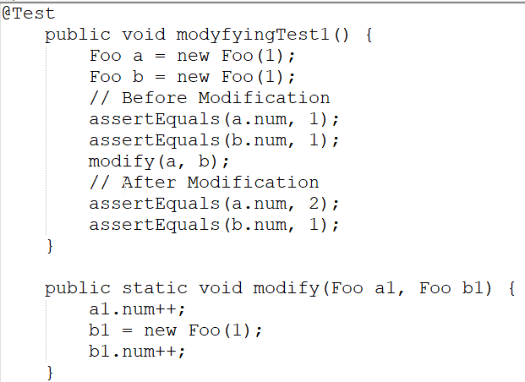
Why do we need this ?
Example 1: will this test pass or fail ?

Slide 3
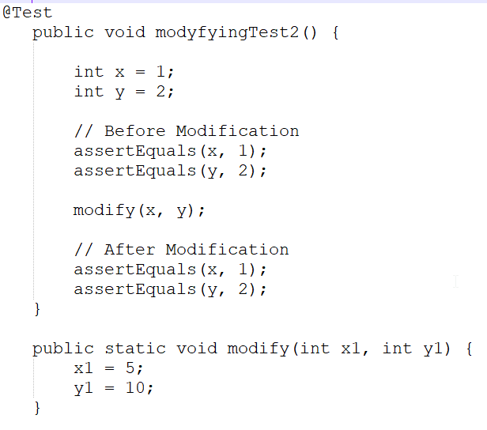
Why do we need this ?
Example 2: will this test pass or fail ?

Slide 4
Java Memory model
There are 4 main components of JVM memory model:
stack;
Heap;
Metaspace;
Garbage collector;
Garbage collector
Metaspace
Stack
Heap
String pool

Slide 5
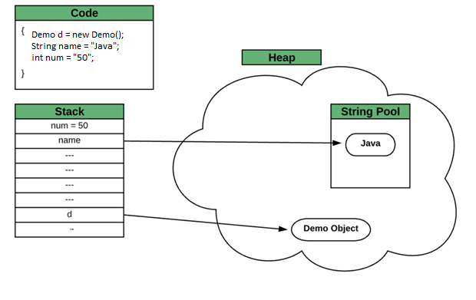
Stack & Heap
During work of application primitives and non-primitives(Java objects) are created.
Stack stores primitives(int, byte, etc) and references to objects.
Objects themselves are kept in heap.
There is also special area in
heap where strings are kept.

Slide 6
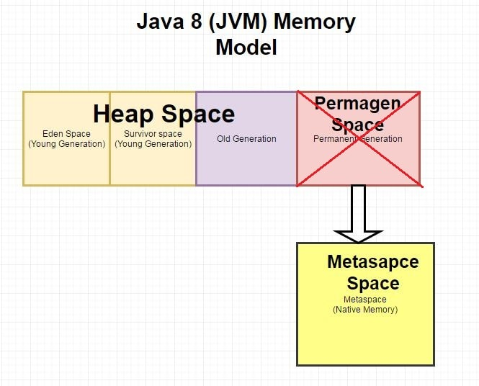
Heap
Eden Space (heap): The pool from which memory is initially allocated for most objects.
Survivor Space (heap): The pool containing objects that have survived the garbage collection of the Eden space.
Tenured Generation (heap): The pool containing objects that have existed for some time in the survivor space.

Slide 7
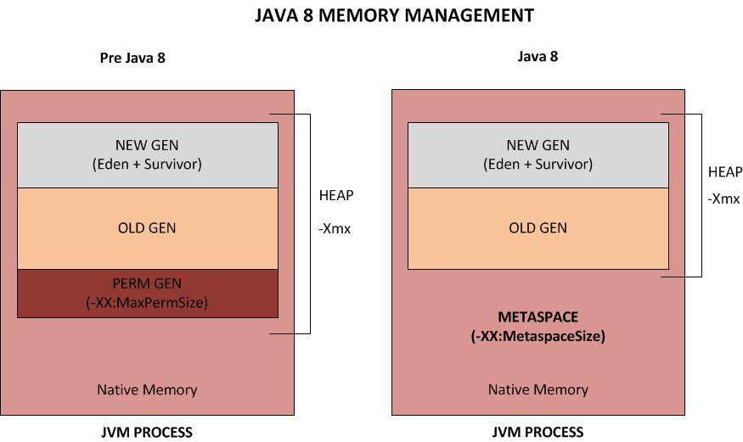
Metaspace
Metaspace is a space for keeping loaded class metadata. This space is separated from the main memory heap.
This native memory region grows automatically by default (up to what the underlying OS provides).
With this improvement in Java 8+ version JVM reduces the chance to get OutOfMemory error.
PermSize / MaxPermSize – min/max PermGen size​
MetaspaceSize / MaxMetaspaceSize
MinMetaspaceFreeRatio / MaxMetaspaceFreeRatio – min/max percentage of class metadata capacity free after garbage collection​

Slide 8
Garbage collector
Java garbage collection is the process by which Java programs perform automatic memory management.
Java programs compile to bytecode that can be run on a Java Virtual Machine, or JVM for short.
When Java programs run on the JVM, objects are created on the heap,
which is a portion of memory dedicated to the program. Eventually, some objects will no longer be needed.
The garbage collector finds these unused objects and deletes them to free up memory.
Garbage collection frees the programmer from manually dealing with memory deallocation.
GC works in two simple steps:​
Mark – this is where the garbage collector identifies which pieces of memory are in use and which aren't.​
Sweep – this step removes objects identified during the “mark” phase.​
​

Slide 9
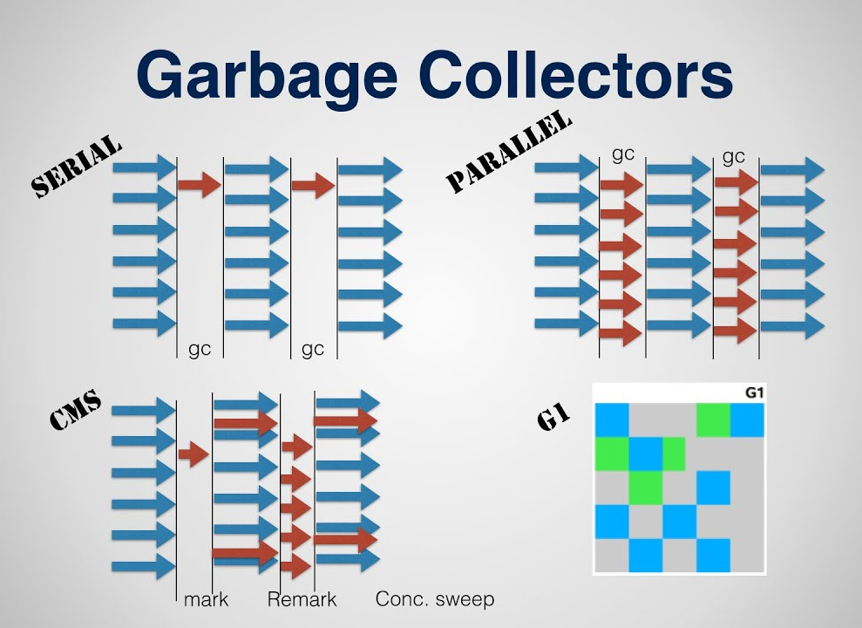
Garbage collector
JVM has five types of GC implementations:​
Serial Garbage Collector​
Parallel Garbage Collector​
CMS Garbage Collector​
G1 Garbage Collector​
Z Garbage Collector
You can call specific GC manually:
java -XX:+UseG1GC -jar Application.java
Perfect candidate for garbage collection – unreachable object

Slide 10
Garbage collector
Garbage collector ​information to remember
GC works in two simple steps:​
Mark
Sweep
There are 5 GC implementations
You can specify GC version manually

Slide 11
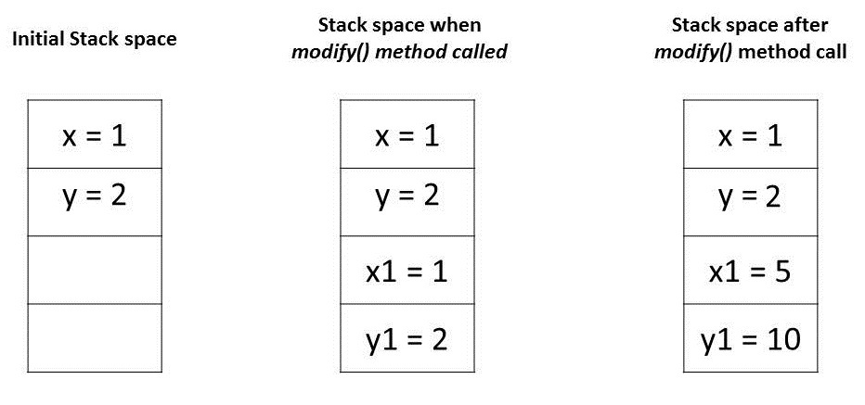
Pass by value
Primitives are passed by
value. E.g. they are not kept in heap
and code has returned from method
local variables are immediately cleaned up.

Slide 13
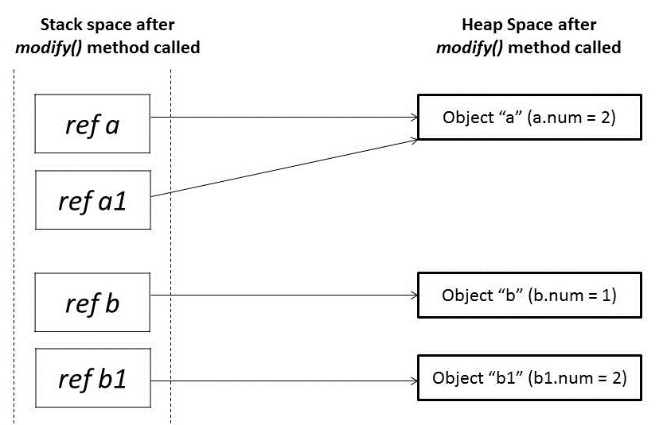
Pass by reference
As we can see, object in heap is passed to
Method by reference, BUT the reference itself
is passed by value and all copies of refence
will point to initial object in heap.

Slide 14
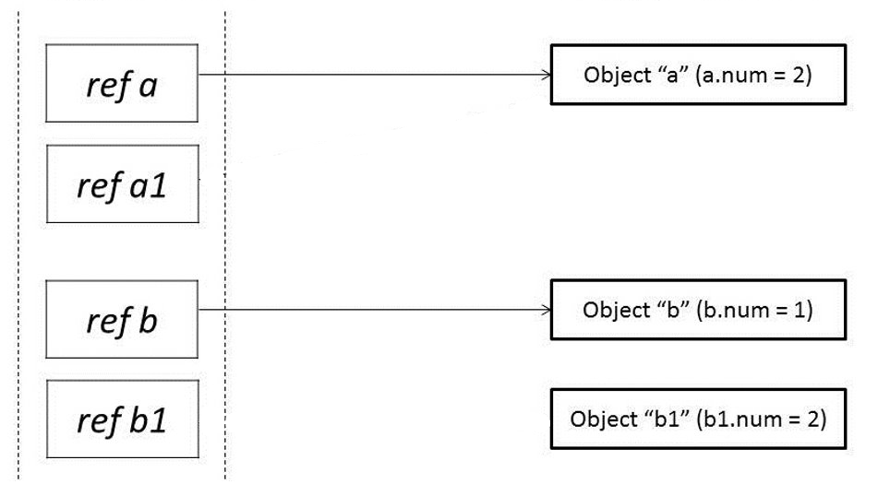

Pass by reference
1

Slide 15
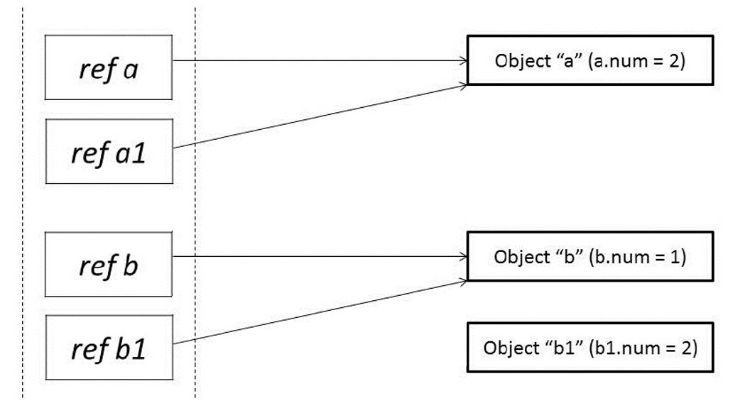
Pass by reference
1

Slide 16
Pass by reference

